Slide 1
Microsoft team
Some error

Slide 2
Outline
Information protection architecture.
Security.
Error.
System down.
Virus scanning.
End-to-End encryption.
Whiteboard

Slide 3
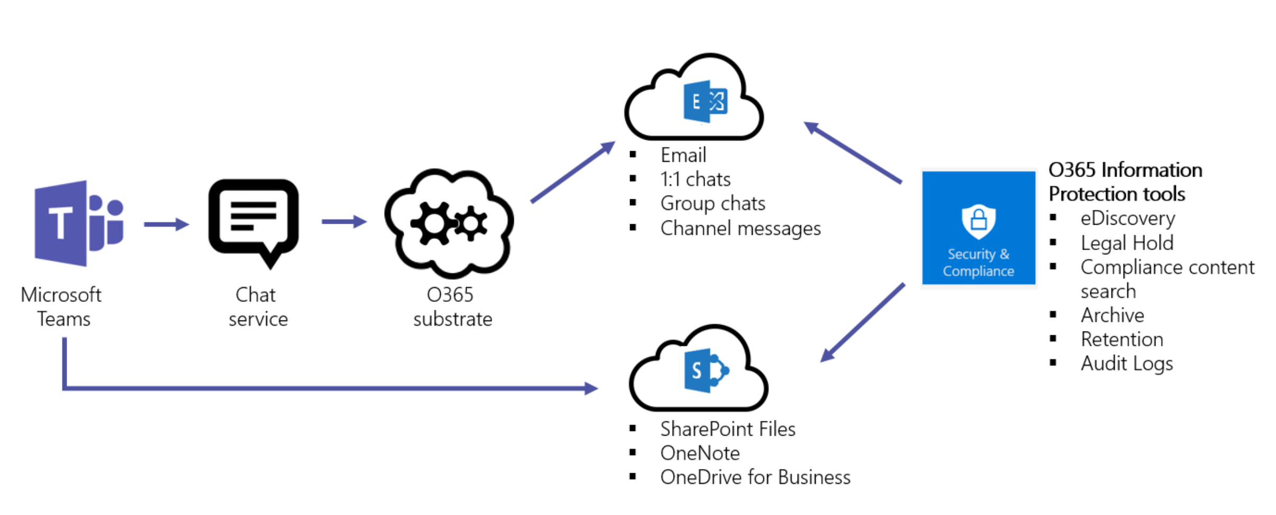
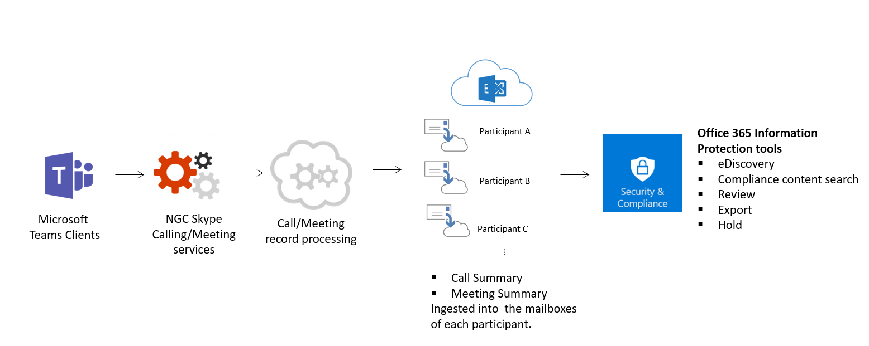
Protection structure

Slide 4
Security
Two-factor authentication.
Single sign-on through Active Directory.
Encryption of data in transit and at rest.

Slide 5
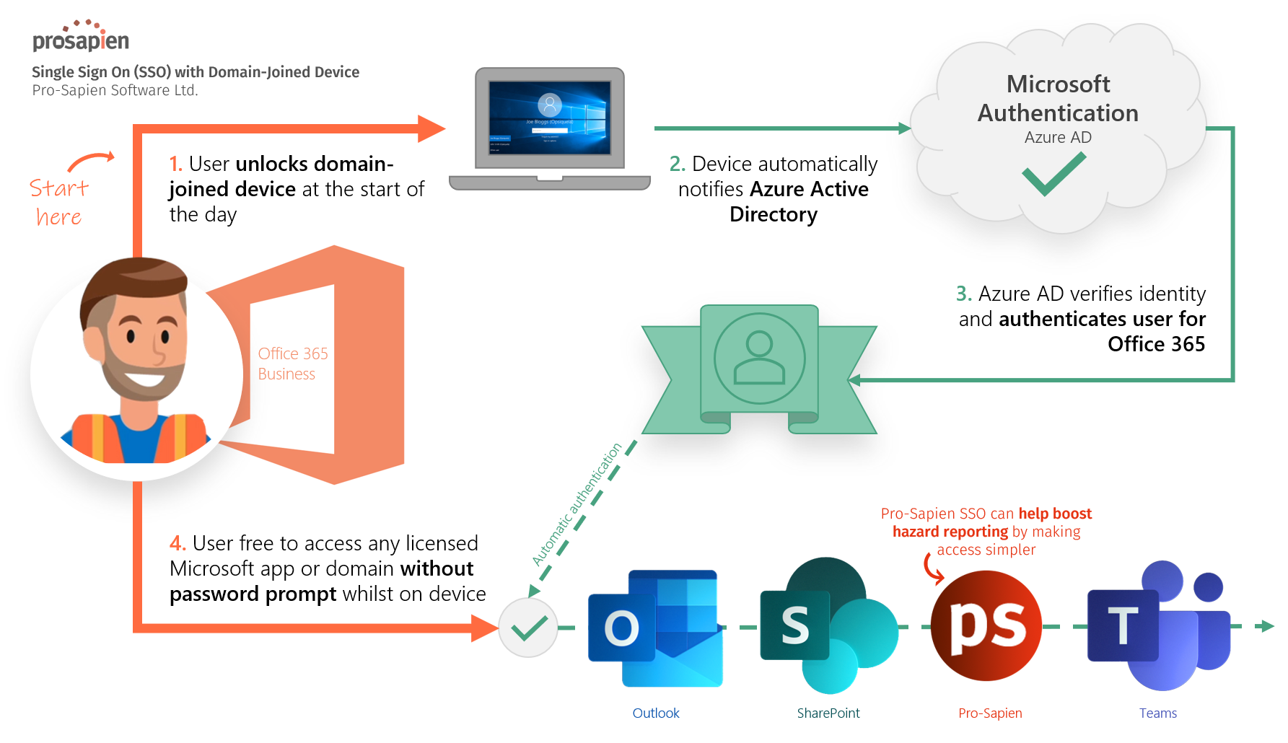
Single sign-on through active directory
Text

Slide 6
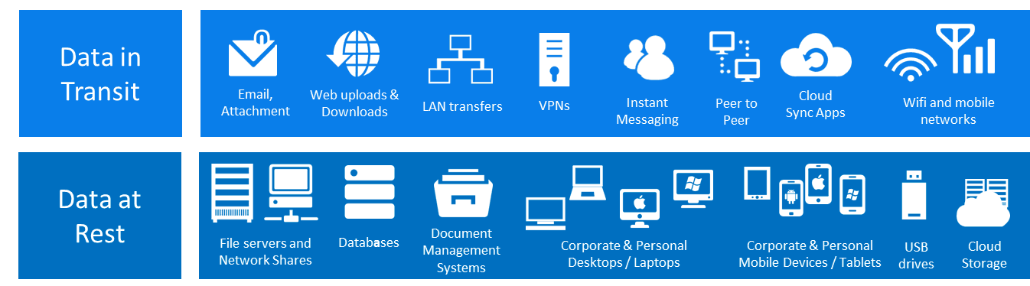
encryption of data
Text

Slide 7
System down

Slide 8
Virus scanning

Slide 9
End-to-end encryption

Slide 10
Microsoft whiteboard
Not showing up in Teams for some users
Files stopped syncing the cloud
Lost 2 months of notes

